Slide 1
Introduction to Database System
Session 01
Rico Halim, S.Kom., M.Kom.

Slide 2
Learning Outcomes
Session 1
At the end of this session, students will be able to:
LO-1 : Define model data and information in the form of conceptual and apply them to the DBMS, both individually and in teamwork.

Slide 3
outline
Session 1
What is a Database and DBMS?
Do We Always Need a DBMS?
Database Users and Actors
Seeing Data in Action

Slide 4

What is a Database and DBMS?
What is a Database?
A database is an organized collection of related data that can be easily accessed, managed, and updated.
Analogy: a well-organized filing cabinet where every document has its place and can be found instantly.
Key properties: represents some aspect of the real world (mini-world), logically coherent, designed for a specific purpose.

Slide 5
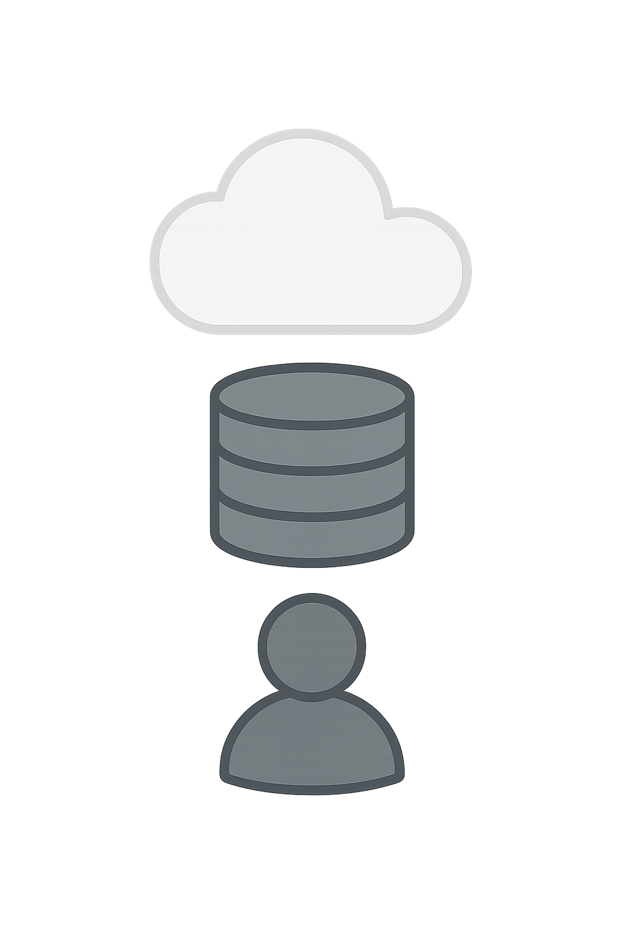
What is a Database and DBMS?
What is a DBMS?
DBMS (Database Management System) = software that manages the database.
Analogy: if the database is the filing cabinet, the DBMS is the librarian who organizes, retrieves, and protects it.
Examples: MySQL, PostgreSQL, Oracle, SQL Server, MongoDB.

Slide 6
What is a Database and DBMS?
Four Main Functions of a DBMS
Define: specify data types, structures, and constraints
  Example: deciding that a Customer table needs columns for name (text), email (text), and registration date (date).
  Think of it as creating the "blueprint" before building.
Construct: store data on a storage medium
  Example: after defining the structure, we fill the Customer table with 10,000 customer records.
  The DBMS handles how and where data is physically saved on disk.

Slide 7
What is a Database and DBMS?
Four Main Functions of a DBMS
Manipulate: Querying, updating, and generating reports from the data.
  Example: "Show me all customers from Jakarta who registered this month" or updating a customer's phone number.
  This is what you will do most often as a database user.
Share: Multiple users and applications access the same data at the same time.
  Example: a cashier processes an order while the manager checks today's sales report, both using the same database.
  The DBMS makes sure they don't interfere with each other.

Slide 8
Do We Always Need a DBMS?
The problem with traditional file processing
  Imagine a company where Sales, Finance, and HR each store their own files independently. What could go wrong?

Slide 9
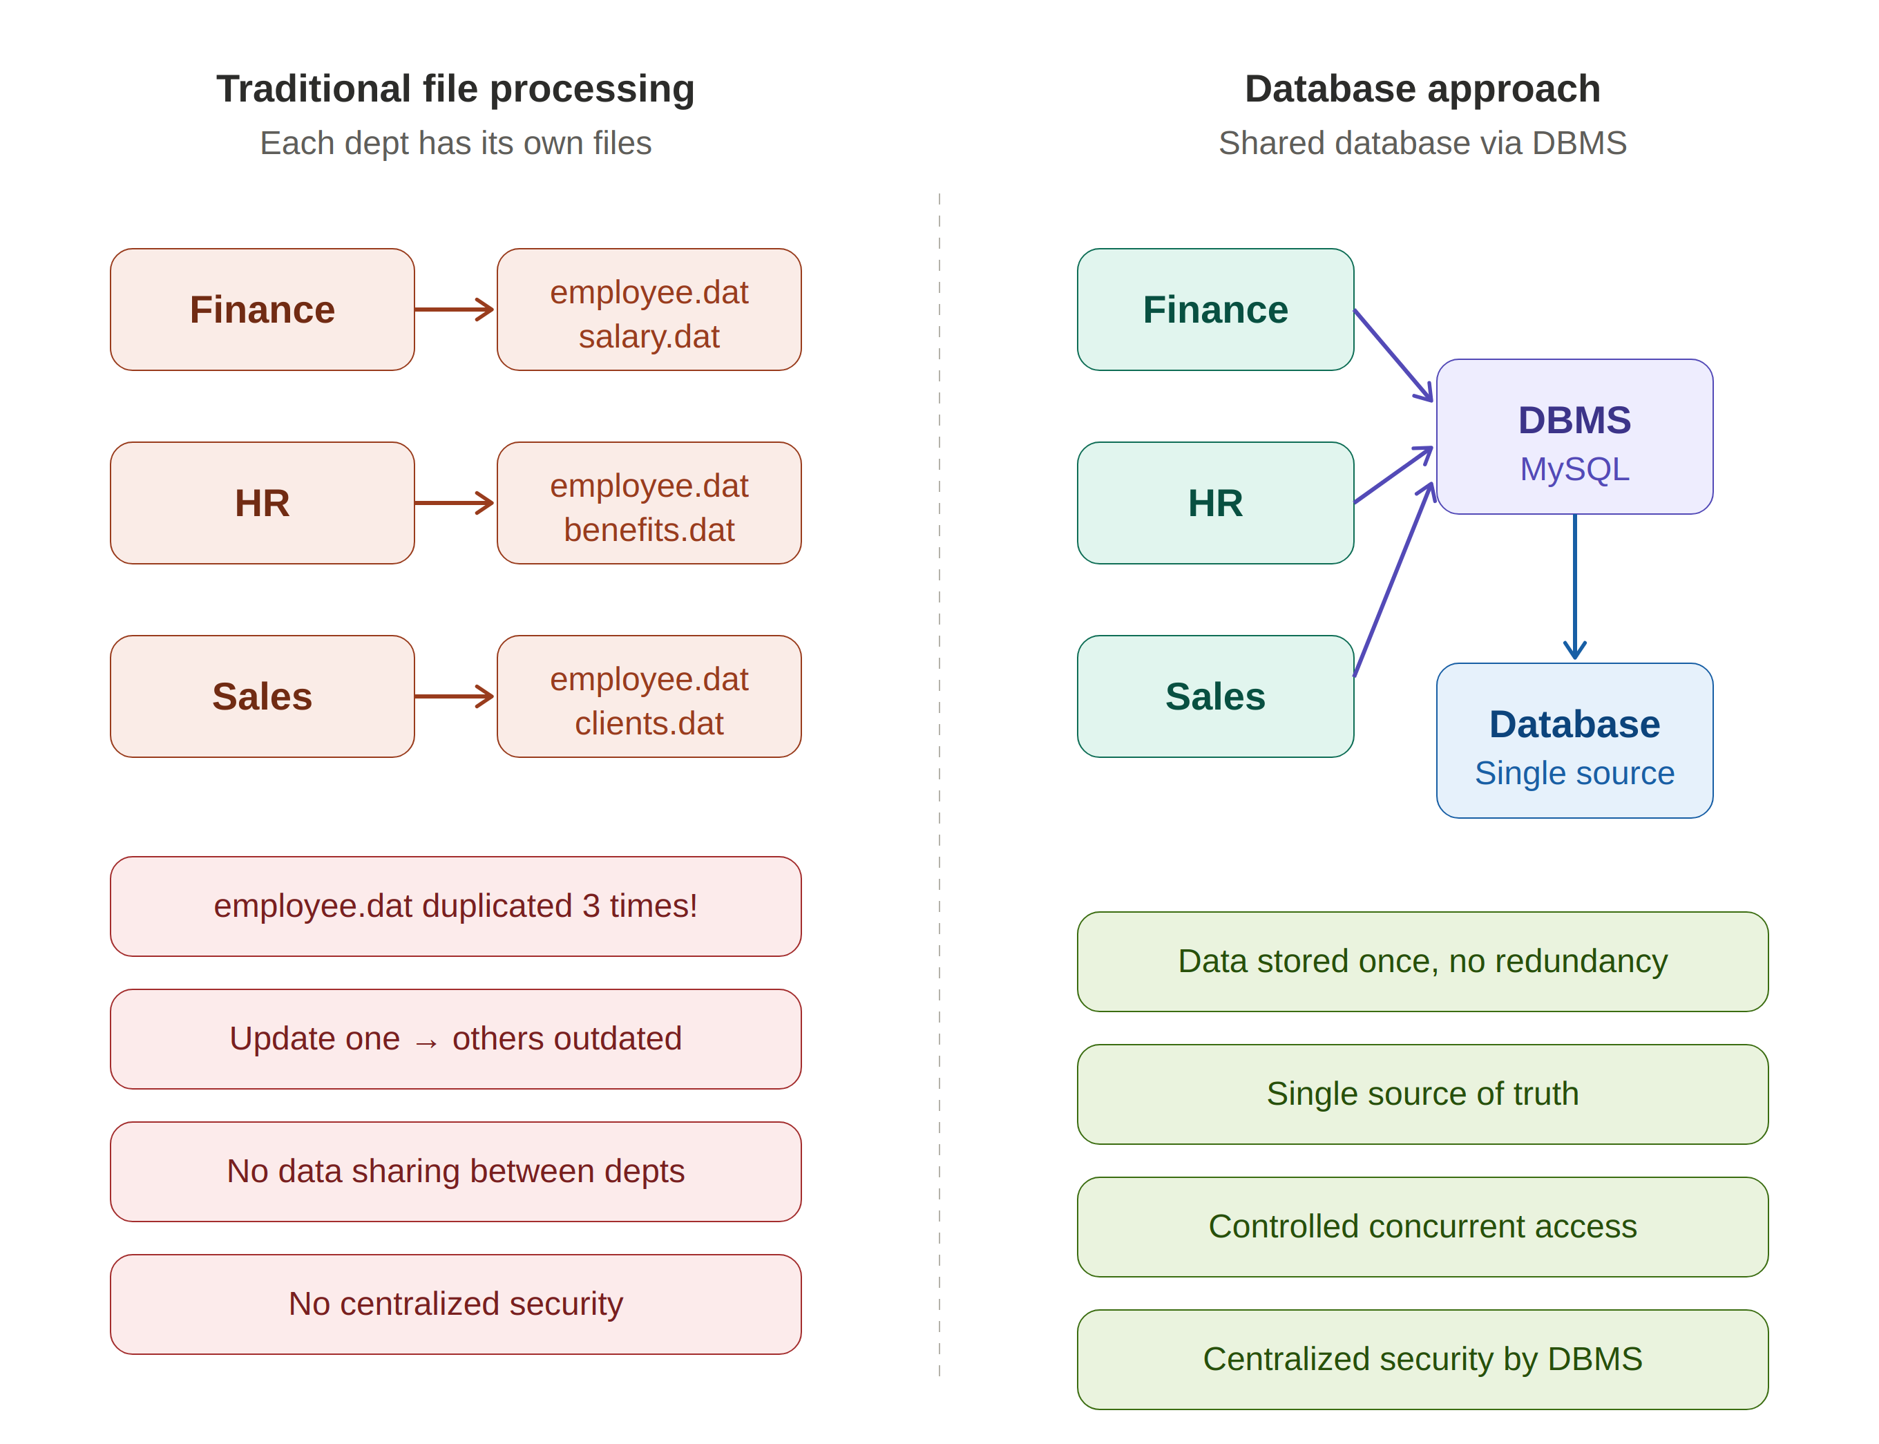
Do We Always Need a DBMS?
File Processing vs. Database: Side-by-Side

Slide 10
Do We Always Need a DBMS?
When NOT to use a DBMS
  Simple, well-defined data that won't change
  Tight budget: DBMS has overhead costs (hardware, software, training)
  Single-user, embedded applications with no concurrent access needed
  Real-time requirements where DBMS overhead is too high

Slide 11
Database Users and Actors
Database Administrator (DBA)
The person who manages and maintains the database system day-to-day.
  Controls who can access the data
  Performs backup and recovery
  Monitors and tunes performance
  Example: the person who makes sure Tokopedia's database runs 24/7 without downtime.

Slide 12
Database Users and Actors
Database Designer
The person who designs the structure before the database is built.
  Identifies what data needs to be stored
  Determines how tables relate to each other
  Defines rules and constraints on the data
  Example: the person who decides that a Customer table needs name, email, and phone columns

Slide 13
Database Users and Actors
Other Actors
Application Programmers: Build software that interacts with the database.
  Write code to retrieve, insert, and update data
  Example: the developer who builds the checkout feature in E-commerce
End Users: Use the database through applications, without knowing the technical details
  Interact with data through buttons, forms, and screens
  Example: a customer who clicks "Buy Now" on E-commerce

Slide 14
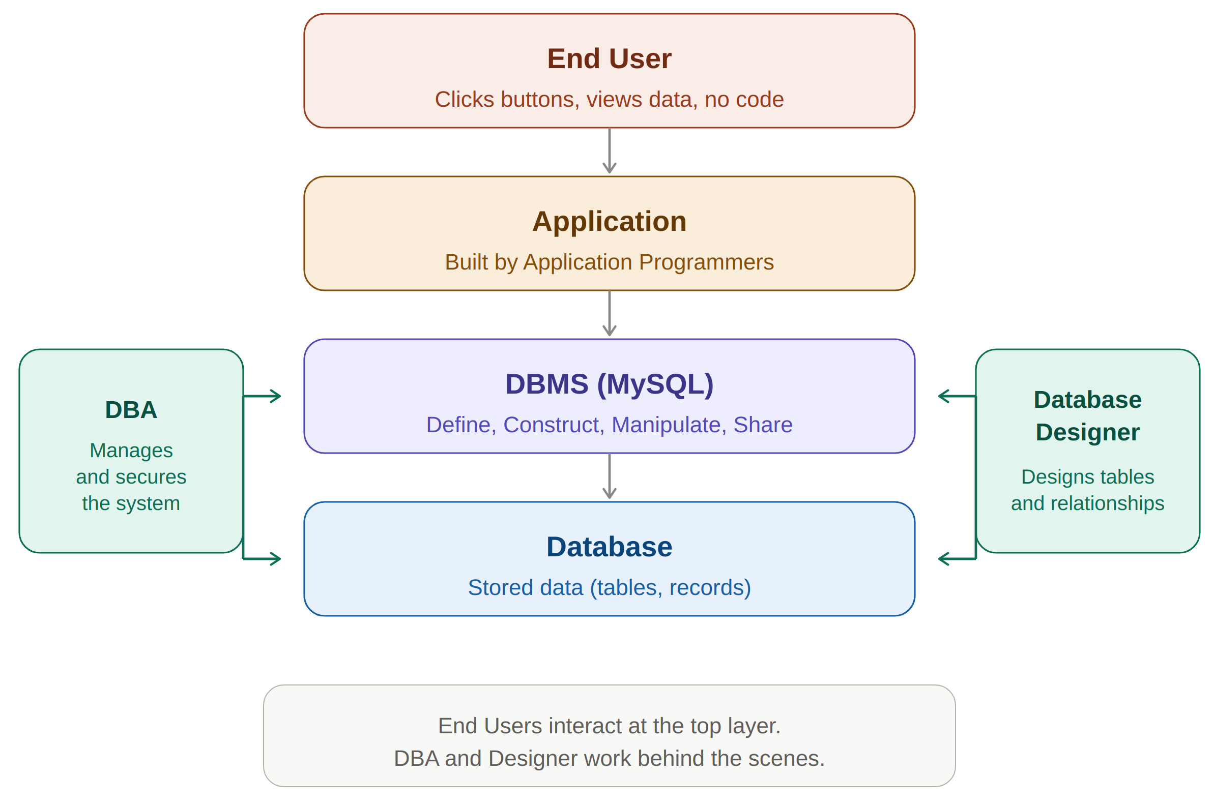
Database Users and Actors

Slide 15
Seeing Data in Action
Example: Online store database
Customer
Order
customer_id | name | email
C001 | Andi Prasetyo | andi.p@email.com
C002 | Siti Nurhaliza | siti.n@email.com
C003 | Budi Santoso | budi.s@email.com
order_id | customer_id | product | order_date
ORD001 | C001 | Mechanical Keyboard | 2025-03-01
ORD002 | C001 | Wireless Mouse | 2025-03-01
ORD003 | C002 | USB-C Hub | 2025-03-05
Key observations:
• C001 (Andi) appears in 2 orders: one customer can have many transactions
• customer_id in the Order table refers to the Customer table, data is connected
• This is the power of a database: structured, linked, and easy to query

Slide 16
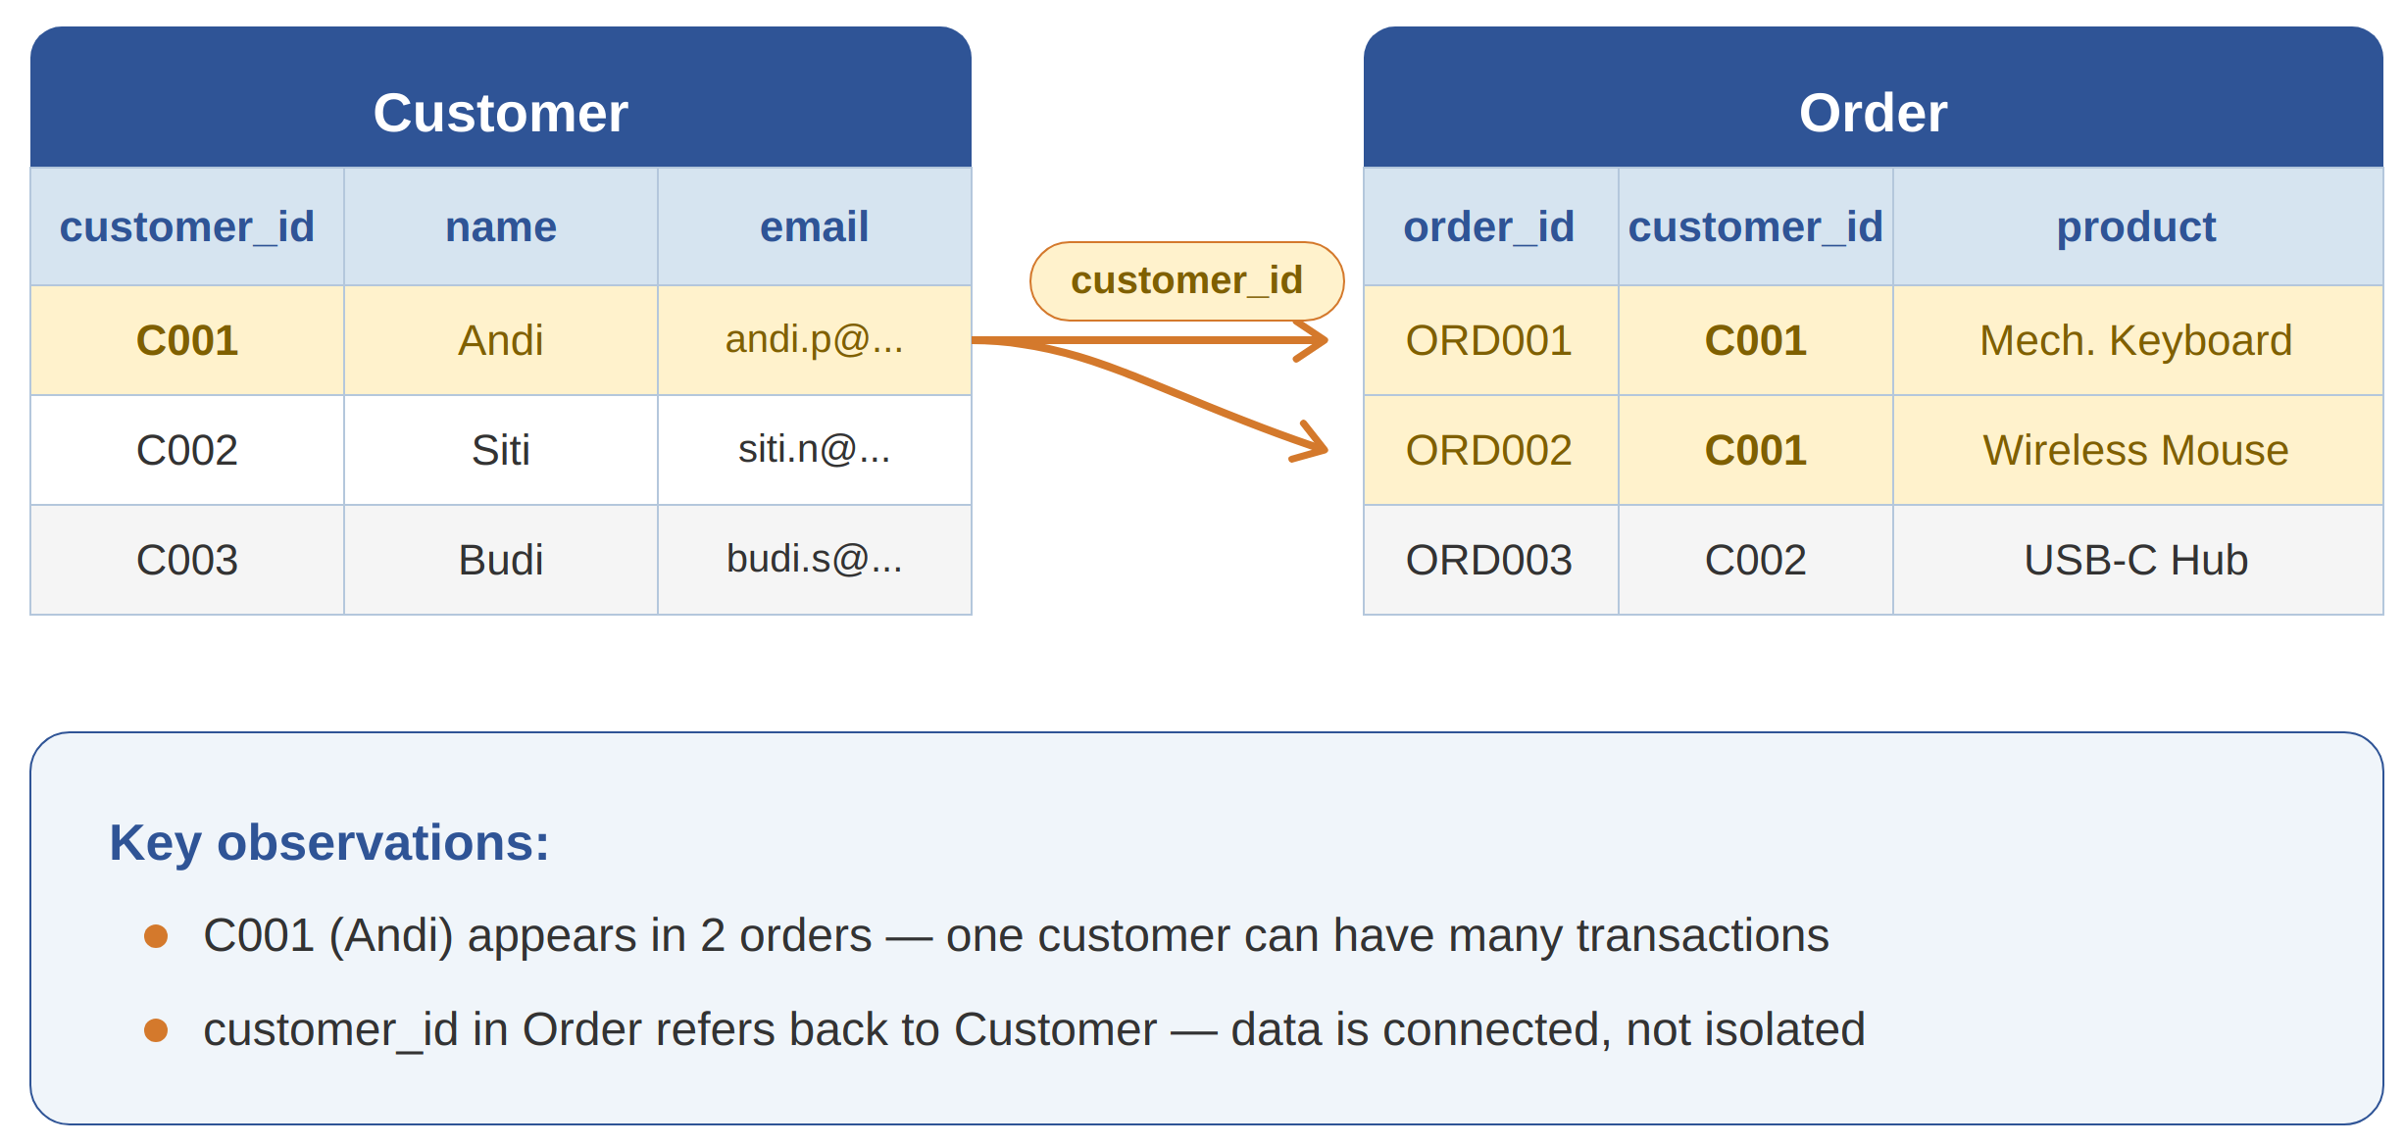
Seeing Data in Action
How data relates to each other

Slide 17
Summary
What is a Database and DBMS? A database is an organized collection of related data. A DBMS is the software that manages it through four main functions: define, construct, manipulate, and share.
Do We Always Need a DBMS? The database approach solves critical problems of file processing such as redundancy, inconsistency, and lack of data sharing. But not every situation requires a DBMS.
Database Users and Actors: Different roles (DBA, Designer, Programmer, End User) work together to build and maintain database systems.
Seeing Data in Action: Data in a database is structured in tables and connected through shared fields, not isolated like in file-based systems.

Slide 18
exercise
Explain in your own words: What is a DBMS and what are its four main functions?
A small company stores customer data in separate Excel files for each department (Sales, Finance, HR). What problems could arise from this approach, and how would a database system solve them?
You are a freelance photographer who manages around 50 clients per year. You currently store client names, phone numbers, and project details in a single notebook. Your business is growing. A friend suggests you use a database system.
  What data would you need to store?
  How is the data related to each other?
  Would you recommend a DBMS for this case? Or is a simpler approach enough? Justify your answer.

Slide 19
References
Session 1
Murach, J. (2023). Murach's MySQL, 4th Edition. Mike Murach & Associates. Chapter 1.
Elmasri, R. & Navathe, S. (2015). Fundamentals of Database Systems, 7th Edition. Pearson. Chapter 1-2.

